Slide 1

The Poem of Life
By Aman Kumar Singh
amansingh844123@gmail.com

Slide 2
Why I chose this
To overcome the tragedies and still manage to be kind. Fleming talks about even when going through a hard time in life, we still must still be true to ourselves and stay kind. There are times in our lives, where we fell like the is world is against us. Also Poetry is so important because it helps us understand and appreciate the world around us.

Slide 3


Poetry is like the Windex on a grubby car window, it bares open the vulnerabilities of human being so we can all relate to each other a little better.
Poetry can be therapeutic for both its writers and its readers

Slide 4
Life is spatial Environment
Seasonal or Ritual moments of Life
Origins (formal or informal ceremonies / private and public moments
BASICS

Slide 5
Important Questions
Where and When is this Life being lived?
What piece of Life, private or public, is concerned with?

Slide 6
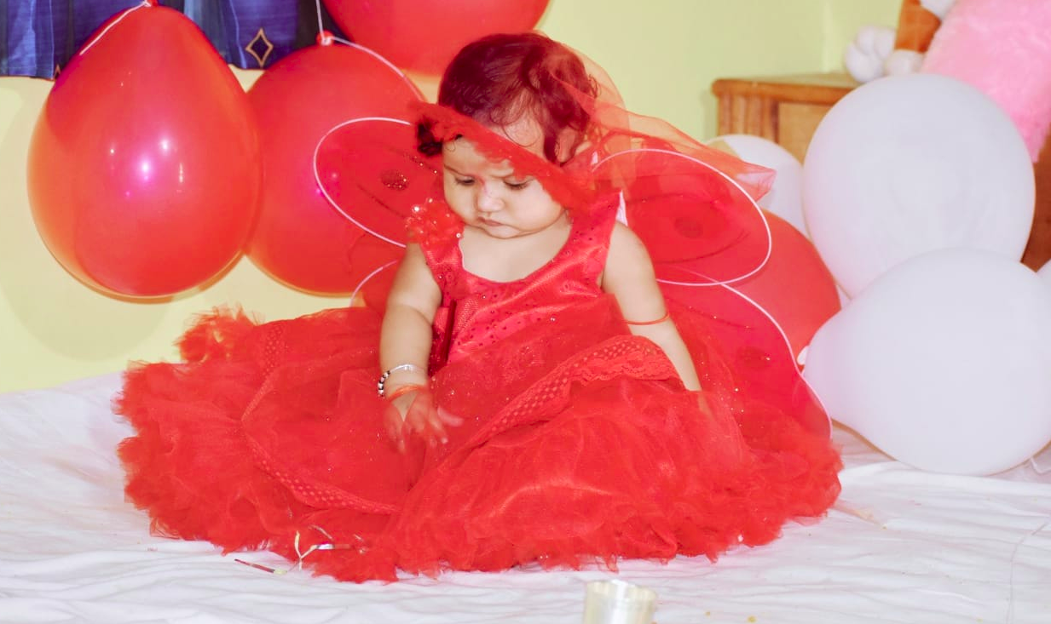



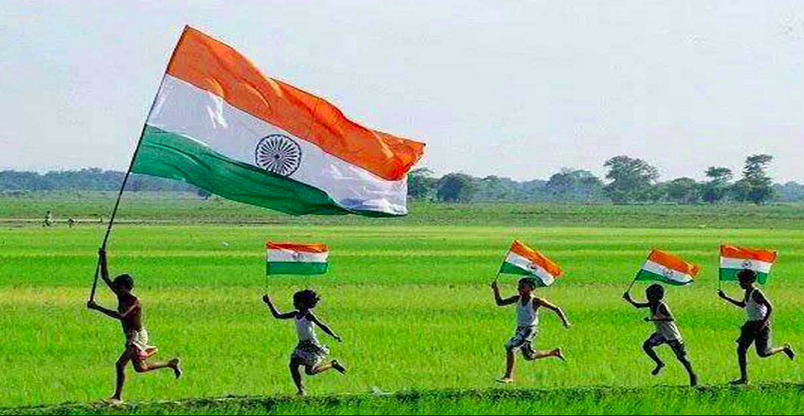
Cliches
In greeting cards and magazines:
Babies are Lovable.
Brides are Beautiful.
Young man should fight in War.
50th wedding Anniversaries are Happy.
Indians should take pride in their country’s history.

Slide 7
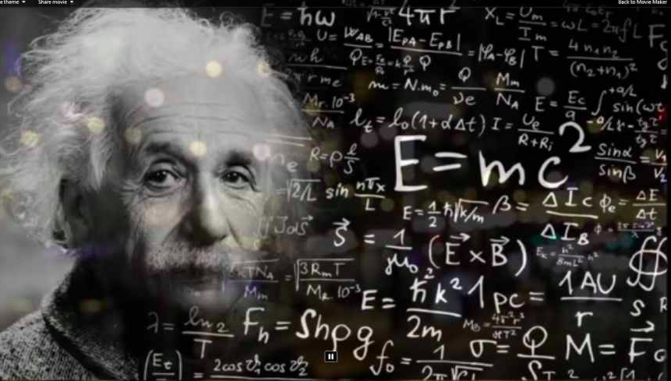
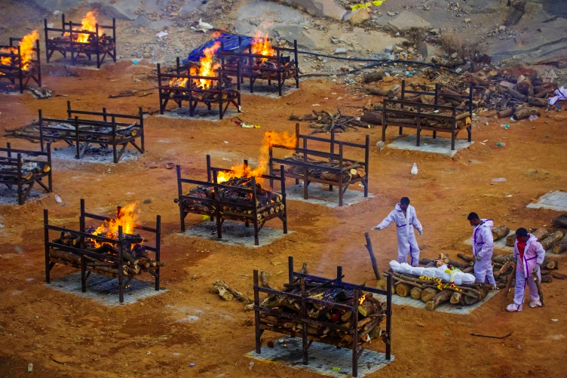
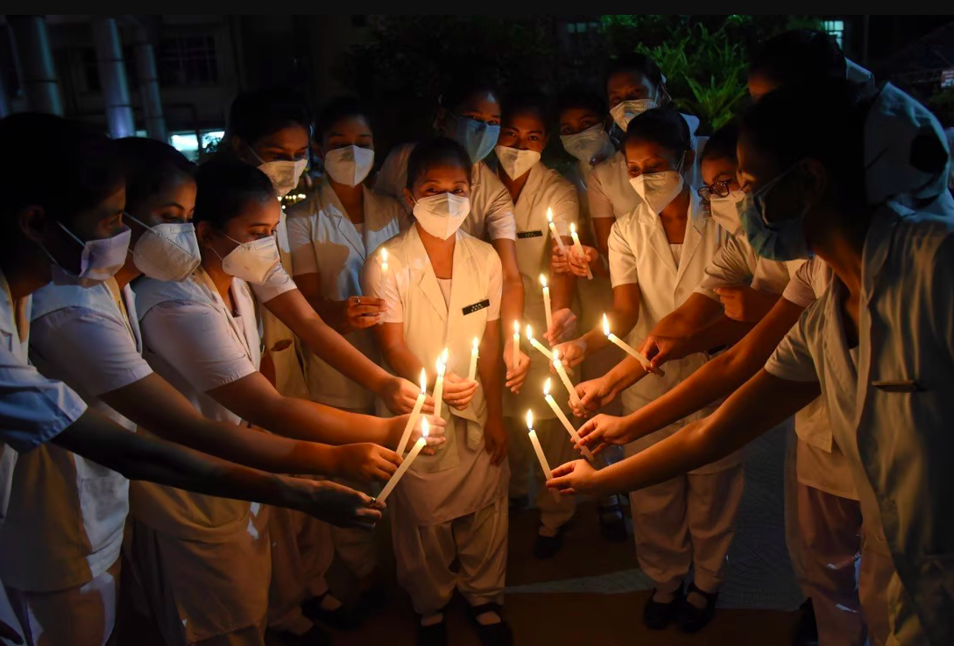
Cliches
Time and Space.
EX: The Springtime of the Life leads only to the narrow space of the Grave.

Slide 8
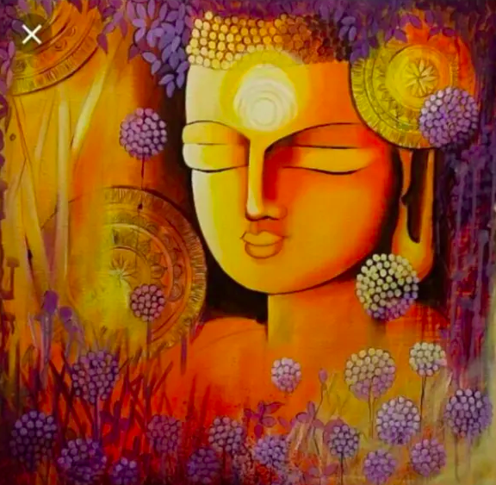
Good poets avoid cliche.
They help us to see event in a new light.
Great poems transcend being mere representations of life and become works of Art.
Originality

Slide 9
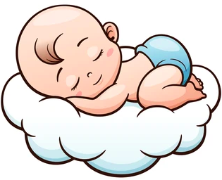
The Private Life
Birth poems “Infant Sorrow” William Blake
What is arresting about this Poem?
Baby as “a fiend hid in a cloud”

Slide 10


Other Private Life Poems
Poems about Childhood “The School Children” Louise Gluck
What makes this Poem Disturbing?
The New Clothes and apples are here--- strangely sinister

Slide 11


In Brief: The Poem of Life
What piece of life is the poem of about?
A disappointment in love
The death of a parent
An absence of a friend
A crises of personal confidence
A moment of fear

